Slide 1

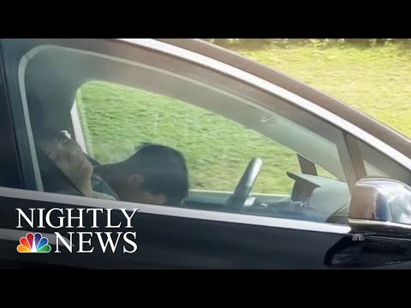

Module 1.6, Case Study #1:
Sleeping Drivers in Self-Driving Cars
Living and Working with Artificial Intelligence
Student Activity Slides
Developed for the AI4GA (Artificial Intelligence for Georgia) project funded by National Science Foundation awards DRL-2049029 and DRL-2048502.
This work is licensed under the Creative Commons. Attribution-NonCommercial-ShareAlike 4.0 International License. https://creativecommons.org/licenses/by-nc-sa/4.0/

Slide 2
Student Activity Slides
Directions: Complete the activities described in the slides and record your answers on the slides or add a slide if you need more room.
Notes:
Student Notes: Complete the activities described in the slides and record your answers.

Slide 3
Video: Tesla Driver Caught On Camera Apparently Asleep At The Wheel | NBC Nightly News
As you watch the video,
think about
What do you find interesting or surprising?
What do the producers of the video want you to learn?
https://www.youtube.com/watch?v=NHUZxeSUFUk (1:35)

Slide 4
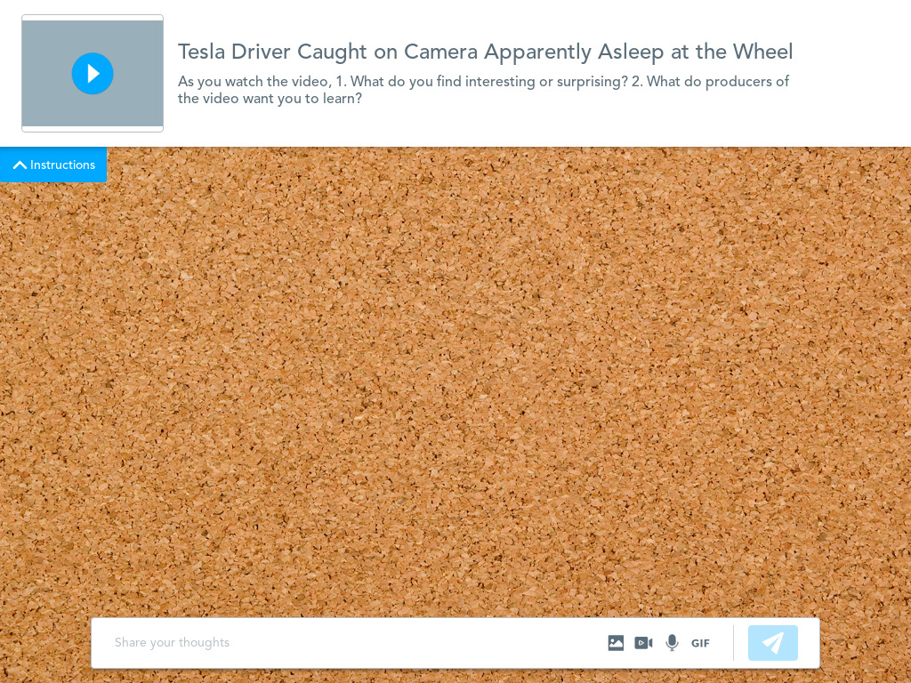
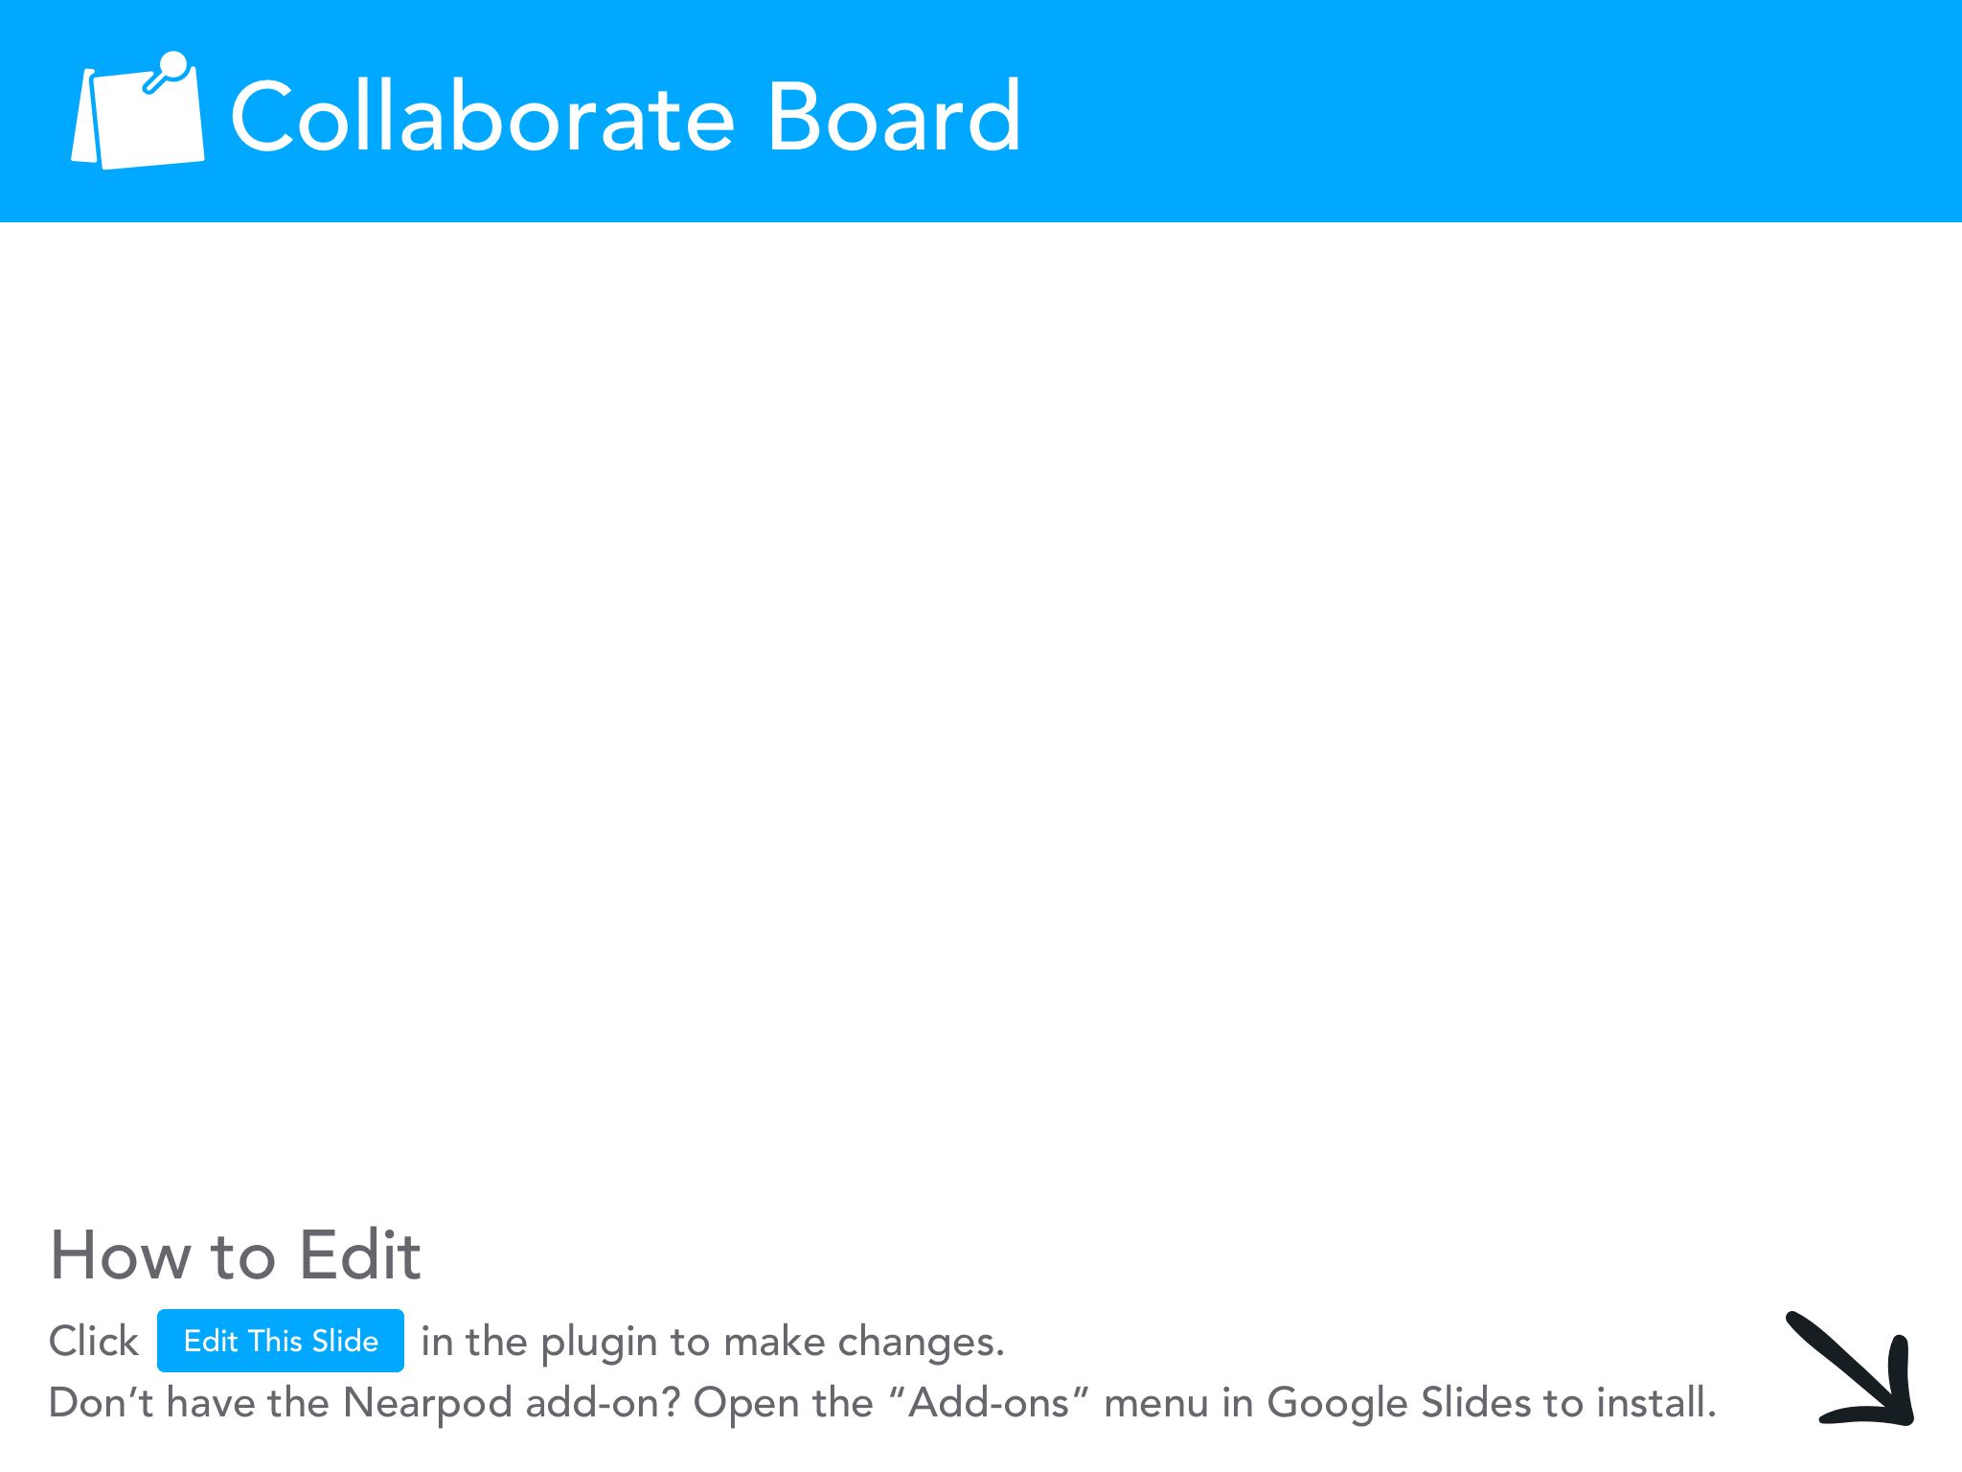

Slide 5
Video: Tesla Driver Caught On Camera Apparently Asleep At The Wheel | NBC Nightly News
Let’s watch it again
Is the human using the self-driving car as it was intended?
Is this responsible behavior?
Is this behavior legal?
Is it safe behavior?
Are the sensors operating properly?
https://www.youtube.com/watch?v=NHUZxeSUFUk (1:35)

Slide 6
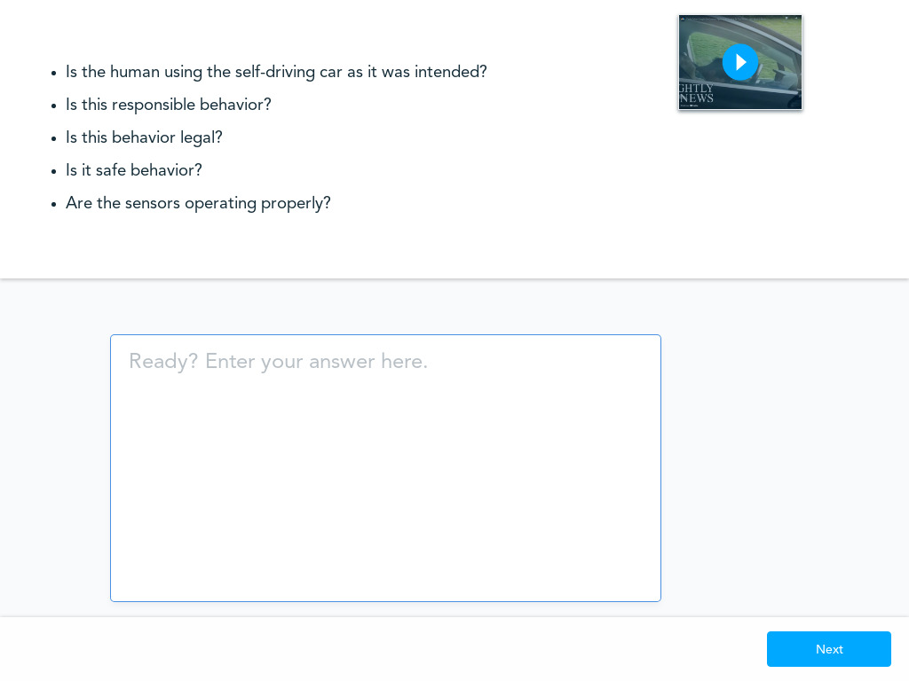
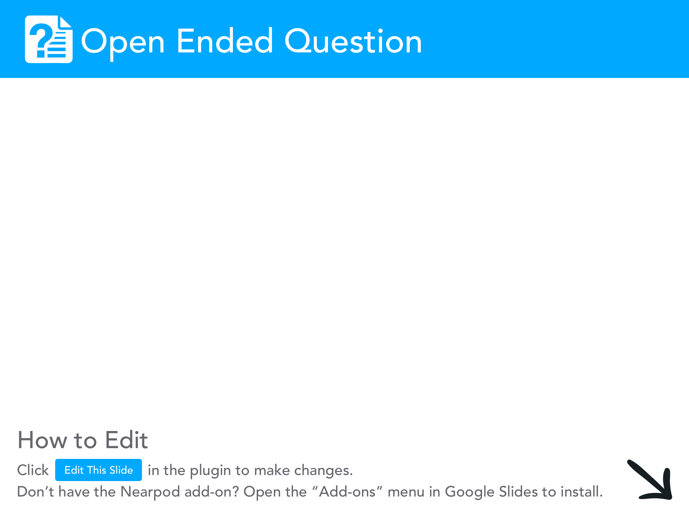

Slide 7
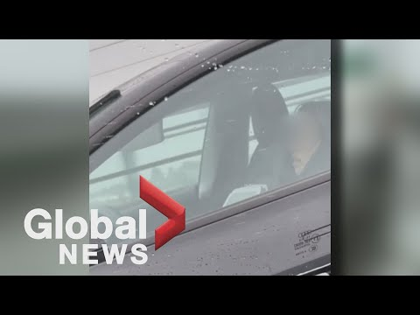
Video: Video shows Tesla driver seemingly asleep at the wheel on a BC bridge during rush hour
Let’s watch a new video and keep these questions in mind
Is the human using the self-driving car as it was intended?
Is this responsible behavior?
Is this behavior legal?
Is it safe behavior?
Are the sensors operating properly?
https://www.youtube.com/watch?v=WQyliOXgNnc (2:13)

Slide 8


Slide 9
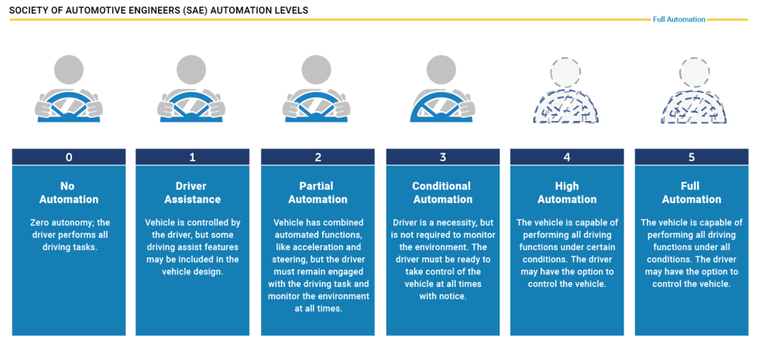
What level of autonomy is Tesla’s Autopilot mode?
Notes:
Source: https://www.sciencealert.com/tesla-driver-caught-sleeping-for-more-than-30-miles-on-one-of-california-s-busiest-freeways

Slide 10
What level of autonomy is Tesla’s Autopilot mode?
Student ID# ____________________
Instructions: Circle your answer below and explain why
Notes:
Source: https://www.sciencealert.com/tesla-driver-caught-sleeping-for-more-than-30-miles-on-one-of-california-s-busiest-freeways

Slide 11
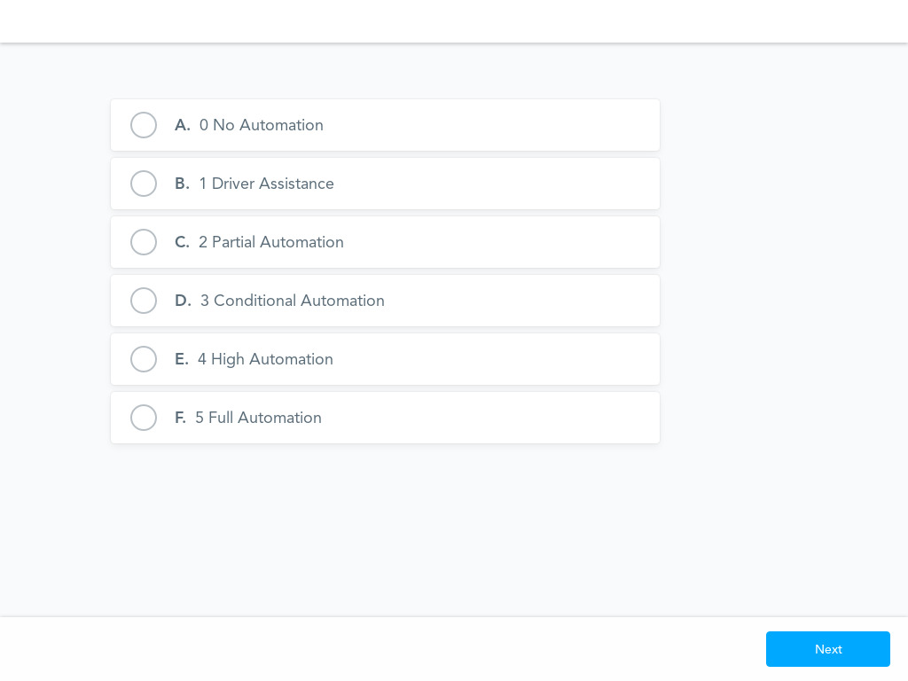
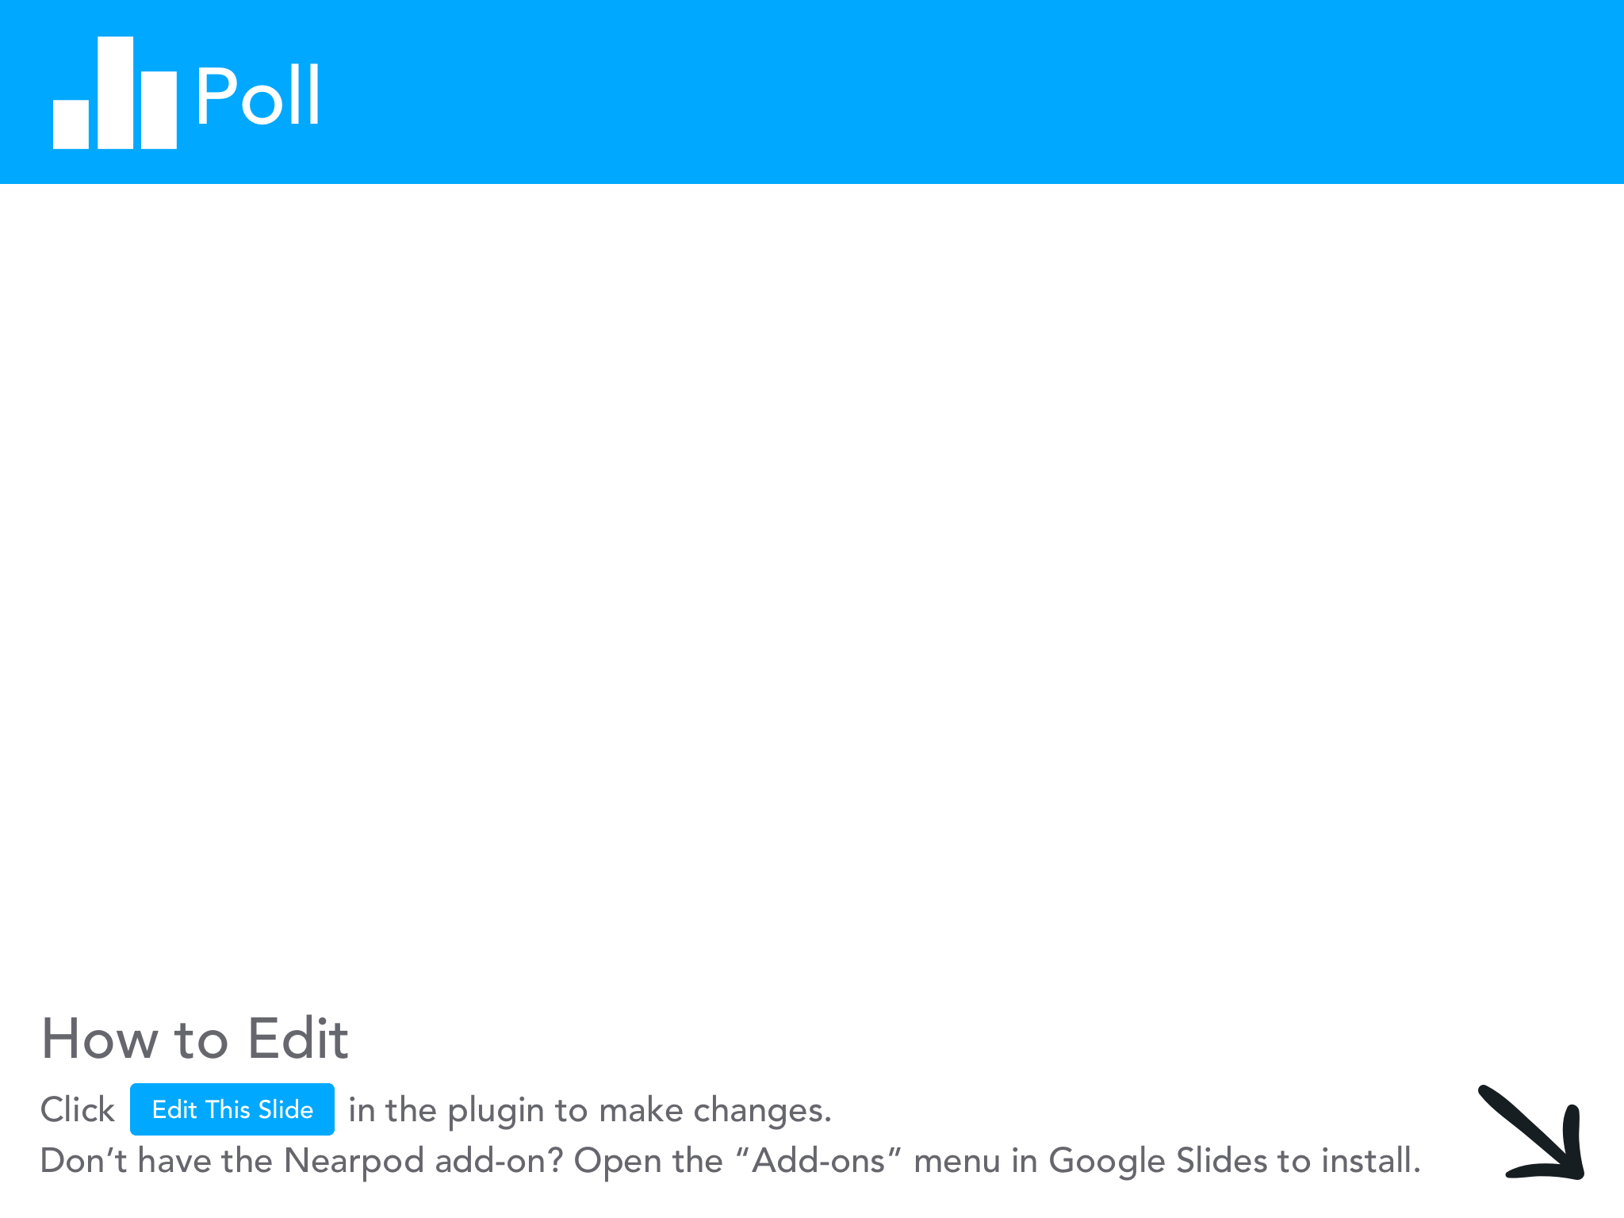

Slide 12
What level of autonomy do you think sleeping drivers associate with Tesla’s Autopilot mode?
Student ID# ____________________
Instructions: Circle your answer below and explain why
Notes:
https://www.sciencealert.com/tesla-driver-caught-sleeping-for-more-than-30-miles-on-one-of-california-s-busiest-freeways

Slide 14
Ethical Reflection: Is it enough to warn people not to do something even though you know they won’t listen?
Yes, explain why
No, explain why

Slide 15


Slide 16
Is Tesla’s Autopilot mode an attractive nuisance?
Basic Elements of Attractive Nuisance
A potentially dangerous condition exists on the property.
The landowner created or maintained the potential hazard.
The landowner should have known the condition would attract children.
The landowner should have known the condition could harm children.
Examples:
Swimming pools
Trampolines
Tree houses
Fountains
Machinery (lawnmowers, gasoline pumps, etc.)
Wells
Tunnels
Dangerous animals
Perspective: Given this definition of Attractive Nuisance, do you consider Tesla’s Autopilot mode a type of attractive nuisance? Why?

Slide 17
Policy Reflection: Should Autopilot Mode be banned?
Directions: Write down several reasons for banning or not banning auto pilot mode
Yes, explain why
No, explain why
Perspective: Which view do you support and why?

Slide 18


Slide 19
Reflection: Do you think the penalty drivers received for sleeping while their car is driving in autopilot mode is appropriate given the possible safety risks?
Directions: What are the penalties? Are they appropriate?
Yes, explain why
No, explain why
Perspective: Which view do you support and why?
Notes:
Student Note: Both videos provide some answers about the consequences. You can do a little research to answer this question.

Slide 21
Deeper Dive: What are the driver assistance features of Tesla’s Cars?
Read: https://www.tesla.com/support/autopilot
Auto-Pilot Mode
Fully Autonomous

Slide 22
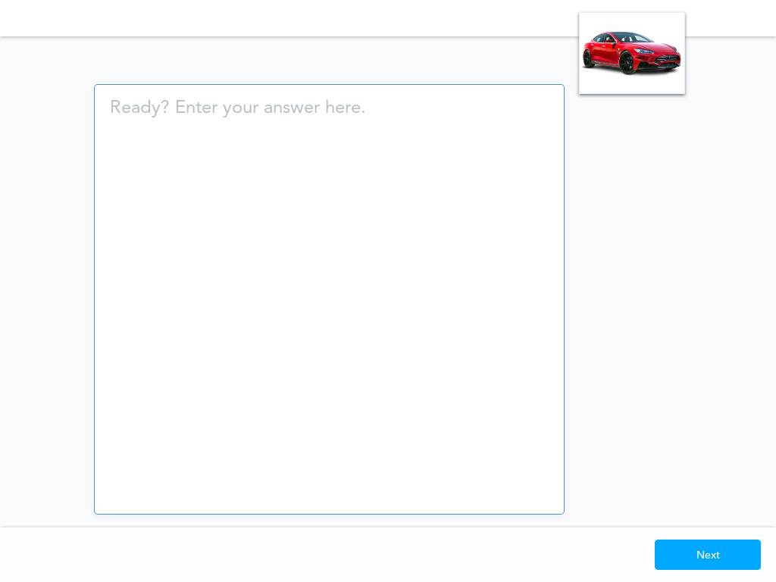

Slide 23
Optional: Resources
Additional Videos
Driver asleep at the wheel of his Tesla on busy freeway in Los Angeles
Tesla Driver Pulled Over After Appearing To Be Asleep While Driving
Tesla Owner Caught Sleeping Behind The Wheel On Autopilot (20 minutes, bodycam)

